Slide 1

Apache Spark™

Slide 2
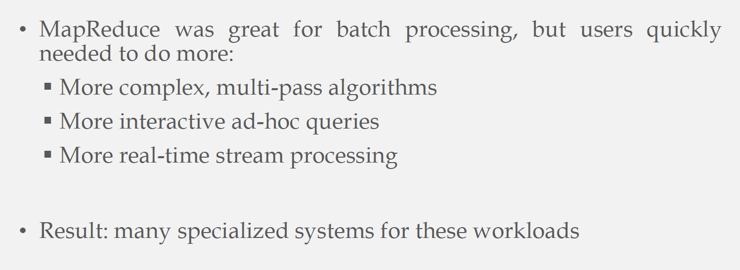

Why Need Another Infrastructure
Hadoop is used by many applications, each has some diverse requirements and needs

Slide 3
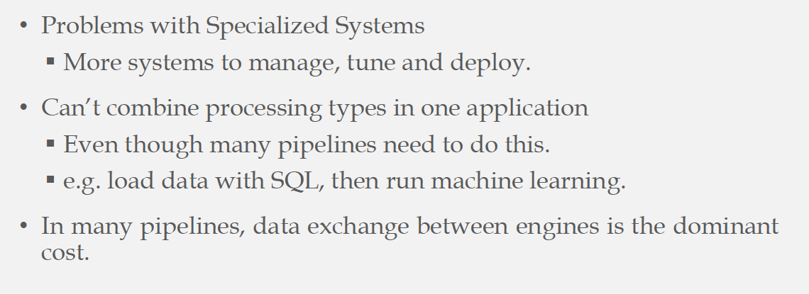

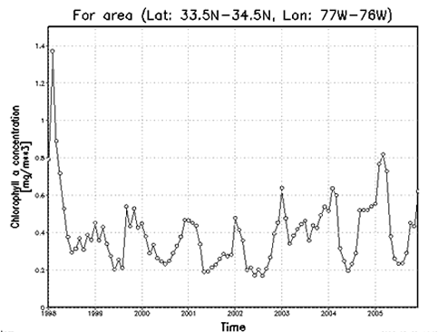
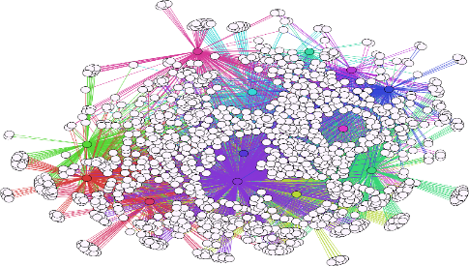
Specialized Systems: Downside
One application may need them all

Slide 4
Vision: Generic Efficient Infrastructure
SQL
Stream
ML
Graph
Common Engine

Slide 5
Apache Spark
Apache Spark is an open source, general-purpose distributed computing engine
Used for processing and analyzing a large amount of data
Works with the system to distribute data across the cluster and process the data in parallel
Uses master/slave architecture i.e. one central coordinator and many distributed workers

Slide 6
Why Spark? Why not Hadoop ??????????
Difference in approach of processing
Unified processing engine
Spark can do it in-memory, while Hadoop MapReduce has to read from and write to a disk
Spark may be up to 100 times faster
Hadoop MapReduce is able to work with far larger data sets than Spark
Polyglot

Slide 9
Run time architecture of Apache Spark

Slide 10

Spark Session

Slide 11
Driver Program
The driver is the process that runs the user code
Creates Spark Session
Each Spark application will have its own driver program
Spark Session acts as entry point to user code

Slide 12
Responsibilities of Driver Program
Maintaining information about the Spark Application
Responding to a user’s program or input
Analyzing, distributing, and scheduling work across the executors
Maintains all relevant information during the lifetime of the application

Slide 13
Executors
The executors are responsible for actually carrying out the work that the driver assigns them
Responsible for
executing code assigned to it by the driver
reporting the state of the computation on that executor back to the driver node

Slide 14
Apache Spark Cluster Manager
Spark relies on cluster manager to launch executors and in some cases, even the drivers launch through it
Is responsible for maintaining a cluster of machines that will run spark application(s)
It is a pluggable component in Spark
Spark supports – standalone cluster manager, Apache Mesos, and Hadoop YARN

Slide 15
Spark Unified Stack

Slide 16
Spark Core
Provides all the necessary functionalities to manage and run distributed applications
Consists of
distributed computing infrastructure
RDD programming abstraction

Slide 17
Distributed Computing Infrastructure
Responsible for the distribution, coordination, and scheduling of computing tasks across many machines in the cluster
Handling of computing task failures
Data Shuffling (efficiently move data across machines)

Slide 18
RDD – Resilient Distributed Dataset
An RDD is an immutable and fault-tolerant collection of objects partitioned across a cluster that can be operated in parallel
Provides a set of APIs for large-scale data processing
APIs are exposed in multiple programming languages
Supports two types of operations: Transformation and Action

